Slide 1
Apache Flink Overview
A Streaming Framework
Archana Jaiswal

Slide 2
Contents
Introduction
Apache Flink Architecture
01
02
Datasets and DataStream API
Table API and SQL
03
04
Windows and Checkpointing
Conclusion
05
06

Slide 3
Introduction

Slide 4
Unbounded and Bounded Streams
Apache Flink supports both unbounded and bounded streams:
Unbounded streams have a start but no defined end. They do not terminate and provide data as it is generated.
Bounded streams have a defined start and end. Bounded streams can be processed by ingesting all data before performing any computations. Processing of bounded streams is also known as batch processing.

Slide 5

What is Apache Flink?
01
Stream processing framework
Apache Flink is an open-source stream processing framework for distributed, high-performing, always-available, and accurate data streaming applications.
02
Batch processing capabilities
In addition to stream processing, Apache Flink also provides powerful batch processing capabilities for processing large volumes of data efficiently.

Slide 6
What is Flink
Apache Flink is a streaming framework and distributed processing engine
Stateful computations over unbounded and bounded data streams.
Flink has been designed to run in all common cluster environments
Perform computations at in-memory speed and at any scale.
It is distributed
High Performance
Always Available
Robust fault tolerance , application can restart from same point where it failed using state and checkpoitning

Slide 7



Why Apache Flink is Important?
Real-time processing
Fault tolerance
Scalability
Apache Flink enables real-time data processing with low latency and high throughput.
It provides robust fault tolerance mechanisms to ensure data consistency and reliability.
Apache Flink offers seamless scalability to handle large volumes of data efficiently.

Slide 8
Apache Flink Architecture

Slide 9

Overview of Apache Flink Architecture
Data Streaming
Fault Tolerance
Scalability
Apache Flink is a framework and distributed processing engine for stateful computations over unbounded and bounded data streams. Flink has been designed to run in all common cluster environments, perform computations at in-memory speed and at any scale.
Flink ensures data consistency and fault tolerance through checkpoints and savepoints
Flink can scale horizontally to handle large volumes of data and diverse workloads

Slide 10



Data Processing Modes in Apache Flink
01
02
03
Batch Processing
Stream Processing
Data Pipelining
Processing fixed-size datasets at once
Continuous processing of real-time data streams
Efficiently processing data through interconnected stages

Slide 11
Batch Processing VS Real-Time Processing
Batch Processing | Real-Time Processing
Static Files | Event Streams
Processed Periodically in minute, hour, day etc. | Processed immediately (nanoseconds)
Past data on disk storage | In Memory Storage
Example: Bill Generation | Example: ATM Transaction Alert
These days, real-time processing is being used a lot in every organization. Use cases like
fraud detection, real-time alerts in healthcare and network attack alert require real-time
processing of instant data; a delay of even few milliseconds can have a huge impact.

Slide 12
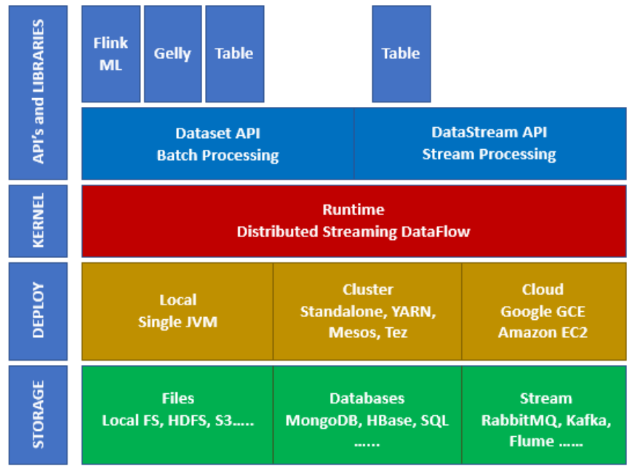
Ecosystem on Apache Flink

Slide 13
Storage
Apache Flink has multiple options from where it can Read/Write data. Below is a basic
storage list:
• HDFS (Hadoop Distributed File System)
• Local File System
S3
• RDBMS (MySQL, Oracle, MS SQL etc.)
• MongoDB
• HBase
• Apache Kafka
• Apache Flume

Slide 14
Deploy Applications Anywhere
You can deploy Apache Fink in local mode, cluster mode or on cloud.
On cloud, Flink can be deployed on AWS or GCP.
Apache Flink is a distributed system and requires compute resources in order to execute applications.
Flink integrates with all common cluster resource managers such as Hadoop YARN, Apache Mesos, and Kubernetes.
It can also be setup to run as a stand-alone cluster.

Slide 15
Run Applications at any Scale
Flink is designed to run stateful streaming applications at any scale.
Applications are parallelized into possibly thousands of tasks that are distributed and concurrently executed in a cluster.
A Flink application can leverage virtually unlimited amounts of CPUs, main memory, disk and network IO.

Slide 16
Leverage In-Memory Performance
Stateful Flink applications are optimized for local state access.
Task state is always maintained in memory.
If the state size exceeds the available memory, it is maintained in access-efficient on-disk data structures.

Slide 17
Layered APIs in Apache Flink
Flink provides three layered APIs. Each API offers a different trade-off between conciseness and expressiveness and targets different use cases.

Slide 18
Libraries in Apache Flink
Flink features several libraries for common data processing use cases. The libraries are typically embedded in an API and not fully self-contained. Hence, they can benefit from all features of the API and be integrated with other libraries.
Complex Event Processing (CEP): Flink’s CEP library provides an API to specify patterns of events.
DataSet API: The DataSet API is Flink’s core API for batch processing applications.
Gelly: Gelly is a library for scalable graph processing and analysis.

Slide 19
Complex Event Processing (CEP)
Pattern detection is a very common use case for event stream processing.
Flink’s CEP library provides an API to specify patterns of events (think of regular expressions or state machines).
The CEP library is integrated with Flink’s DataStream API, such that patterns are evaluated on DataStreams.
Applications for the CEP library include network intrusion detection, business process monitoring, and fraud detection.

Slide 20
DataSet API
The DataSet API is Flink’s core API for batch processing applications.
The primitives of the DataSet API include map, reduce, (outer) join, co-group, and iterate.
All operations are backed by algorithms and data structures that operate on serialized data in memory.
These operations spill to disk if the data size exceed the memory budget.
Algorithms of Flink’s DataSet API are based on database operators, like hybrid hash-join or external merge-sort.

Slide 21
Gelly Library
Gelly is a library for scalable graph processing and analysis.
Gelly is implemented on top of and integrated with the DataSet API.
Gelly benefits from its scalable and robust operators.
Gelly features built-in algorithms, such as label propagation, triangle enumeration, and page ran.
Gelly provides a Graph API that eases the implementation of custom graph algorithms.

Slide 22
SQL & Table API
Flink features two relational APIs, the Table API and SQL.
Both APIs are unified APIs for batch and stream processing.
Queries are executed with the same semantics on unbounded, real-time streams or bounded, recorded streams and produce the same results.
The Table API and SQL leverage Apache Calcite for parsing, validation, and query optimization.

Slide 23
Run Flink Applications 24X7
Flink provides following features to ensure that applications keep running, and remain consistent:
Consistent Checkpoints
Efficient Checkpoints
End-to-End Exactly-Once
Integration with Cluster Managers
High-Availability Setup

Slide 24
Consistent Checkpoints
Flink’s recovery mechanism is based on consistent checkpoints of an application’s state.
In case of a failure, the application is restarted and its state is loaded from the latest checkpoint.
In combination with resettable stream sources, this feature can guarantee exactly-once state consistency.

Slide 25
Efficient Checkpoints
Checkpointing the state of an application can be quite expensive if the application maintains terabytes of state.
Flink can perform asynchronous and incremental checkpoints.
It can keep the impact of checkpoints on the application’s latency SLAs very small.

Slide 26
End-to-End Exactly-Once
Flink features transactional sinks for specific storage systems that guarantee that data is only written out exactly once, even in case of failures.

Slide 27
High-Availability Setup
Flink features a high-availability mode that eliminates all single-points-of-failure.
The HA-mode is based on Apache ZooKeeper, a battle-proven service for reliable distributed coordination.

Slide 28
Savepoints in Flink
Savepoint solves the issue of updating stateful applications and many other challenges.
A savepoint is a consistent snapshot of an application’s state.
Savepoint is very similar to a checkpoint.
Savepoint needs to be manually triggered and is not automatically removed when an application is stopped.

Slide 29
Benefits of Savepoints
Savepoints enable following features:
Application Evolution
Cluster Migration
Flink Version Updates
Application Scaling
A/B Tests and What-If Scenarios
Pause and Resume
Archiving

Slide 30
Flink Monitoring
Flink integrates nicely with many common logging and monitoring services, and provides a REST API to control applications and query information.
Web UI
Logging
Metrics
REST API

Slide 31

Key Components of Apache Flink
01
DataStream API
02
Task Managers
03
Job Managers
Allows for processing unbounded streams of data in real-time
Responsible for executing the tasks assigned by Job Managers and managing the data exchange between tasks
Coordinate the distributed execution of Flink programs, including scheduling tasks and fault tolerance

Slide 32
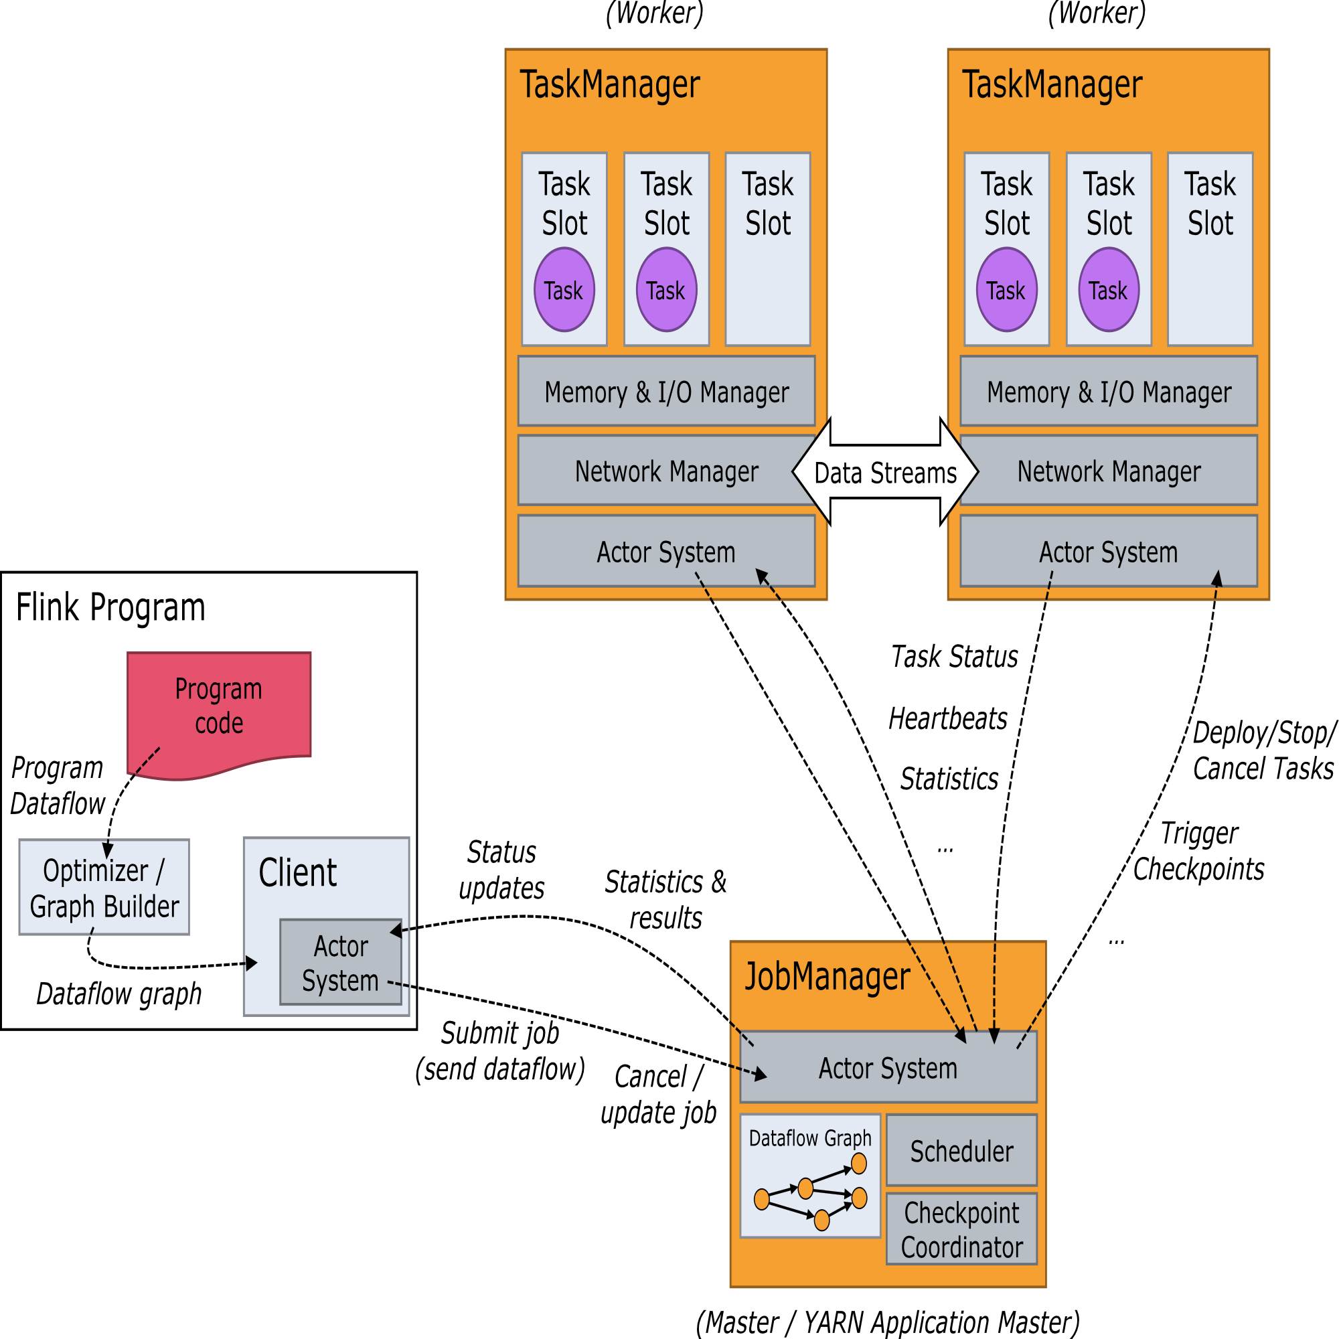
Anatomy of a Flink Cluster

Slide 33
Anatomy of a Flink Cluster
Program
It is a piece of code, which you run on the Flink Cluster.
Client
The Client is not part of the runtime and program execution.
It is responsible for taking code (program) and constructing job dataflow graph, then
passing it to JobManager. It also retrieves the Job results.

Slide 34
Anatomy of a Flink Cluster
JobManager
After receiving the Job Dataflow Graph from Client, it is responsible for creating the
execution graph.
It assigns the job to TaskManagers in the cluster and supervises the
execution of the job.
It decides when to schedule the next task (or set of tasks), reacts to finished tasks or execution failures, coordinates checkpoints, and coordinates recovery on failures, among others.
There is always at least one JobManager.
A high-availability setup might have multiple JobManagers, one of which is always the leader, and the others are standby

Slide 35
Anatomy of a Flink Cluster
This process consists of three different components:
ResourceManager
The ResourceManager is responsible for resource de-/allocation and provisioning in a Flink cluster — it manages task slots, which are the unit of resource scheduling in a Flink cluster (see TaskManagers).
Flink implements multiple ResourceManagers for different environments and resource providers such as YARN, Kubernetes and standalone deployments.
In a standalone setup, the ResourceManager can only distribute the slots of available TaskManagers and cannot start new TaskManagers on its own.

Slide 36
Anatomy of a Flink Cluster
Dispatcher
The Dispatcher provides a REST interface to submit Flink applications for execution and starts a new JobMaster for each submitted job.
It also runs the Flink WebUI to provide information about job executions.
JobMaster
A JobMaster is responsible for managing the execution of a single JobGraph.
Multiple jobs can run simultaneously in a Flink cluster, each having its own JobMaster.

Slide 37
Anatomy of a Flink Cluster
TaskManagers
It is responsible for executing all the tasks that have been assigned by JobManager.
All the TaskManagers run the tasks in their separate slots in specified parallelism.
It is responsible to send the status of the tasks to JobManager.
There must always be at least one TaskManager.
The smallest unit of resource scheduling in a TaskManager is a task slot.
The number of task slots in a TaskManager indicates the number of concurrent processing tasks. Note that multiple operators may execute in a task slot

Slide 38
Datasets and DataStream API

Slide 39
Introduction to Datasets and DataStream API
Batch processing
Process static data sets using Datasets API for batch processing.
Stream processing
Real-time data processing with DataStream API for continuous streams.

Slide 40


Java Code Examples for Datasets API
Transformation Functions
Aggregation Operations
Use map(), filter(), and reduce() functions to transform and manipulate datasets.
Perform aggregation operations like sum, min, max using reduceGroup() and aggregate() functions.

Slide 41

Java Code Examples for DataStream API
DataStream Creation
Use `StreamExecutionEnvironment` to create a DataStream from a collection or file.
Data Transformation
Apply various transformations like `map`, `filter`, and `flatMap` on DataStreams to process data.

Slide 42
Map
DataStream → DataStream #
Takes one element and produces one element. A map function that doubles the values of the input stream:
DataStream<Integer> dataStream = //...
dataStream.map(new MapFunction<Integer, Integer>() {
@Override
public Integer map(Integer value) throws Exception {
return 2 * value;
}
});

Slide 43
Filter
DataStream → DataStream #
Evaluates a boolean function for each element and retains those for which the function returns true. A filter that filters out zero values:
dataStream.filter(new FilterFunction<Integer>() {
@Override
public boolean filter(Integer value) throws Exception {
return value != 0;
}
});

Slide 44
FlatMap
DataStream → DataStream #
Takes one element and produces zero, one, or more elements. A flatmap function that splits sentences to words:
dataStream.flatMap(new FlatMapFunction<String, String>() {
@Override
public void flatMap(String value, Collector<String> out)
throws Exception {
for(String word: value.split(" ")){
out.collect(word);
}
}
});

Slide 45
KeyBy
DataStream → KeyedStream #
Logically partitions a stream into disjoint partitions. All records with the same key are assigned to the same partition. Internally, keyBy() is implemented with hash partitioning. There are different ways to specify keys.
dataStream.keyBy(value -> value.getSomeKey());
dataStream.keyBy(value -> value.f0);

Slide 46
Reduce
KeyedStream → DataStream #
A “rolling” reduce on a keyed data stream. Combines the current element with the last reduced value and emits the new value.
keyedStream.reduce(new ReduceFunction<Integer>() {
@Override
public Integer reduce(Integer value1, Integer value2)
throws Exception {
return value1 + value2;
}
});

Slide 47
DataStream API
StreamExecutionEnvironment env = StreamExecutionEnvironment.getExecutionEnvironment();
env.setStreamTimeCharacteristic(TimeCharacteristic.ProcessingTime);
DataStream<String> text = env.socketTextStream("localhost", 9090);
DataStream<Tuple2<String, Integer>> wordCounts = text.flatMap(new FlatMapFunction<String, Tuple2<String, Integer>>() {
@Override
public void flatMap(String s, Collector<Tuple2<String, Integer>> collector) throws Exception {
String[] words = s.split(" ");
for (String i:words)
collector.collect(new Tuple2<>(i,1)); } })
.keyBy(value -> value.f0)
.window(TumblingProcessingTimeWindows.of(Time.seconds(5))) // Tumbling window of 5 seconds
// .window()
.sum(1);

Slide 48
Time in Event Processing
In stream processing, the concept of time is crucial for understanding and processing data streams. The three different types of time in stream processing are:
Event Time:
Processing Time
Ingestion Time

Slide 49
Time in Event Processing
Event Time:
This is the time at which an event actually occurred, as recorded by the event itself.
Event time is the most accurate representation of when an event took place in the real world, independent of when it is processed by the system.

Slide 50
Time in Event Processing
Processing Time:
This is the time at which an event is processed by the stream processing system.
It depends on when the system receives the event and can be affected by network delays, system load, and other factors.
Processing time is the simplest time concept to implement but may not accurately reflect the actual occurrence time of events, especially when there are delays.

Slide 51
Time in Event Processing
Ingestion Time:
This is the time when an event enters the stream processing system.
It's a middle ground between event time and processing time and is often used in cases where event time is not available but a consistent timestamp is still needed to track when events entered the system.

Slide 52
Window
Windowing is a key feature in stream processing systems such as Apache Flink.
Windowing splits the continuous stream into finite batches on which computations can be performed.
In Flink, windowing can be done on the entire steam or per-key basis.

Slide 53
Window
Keyed window is windowing for the keyed stream, using keyBy(…) method, and then we invoke the window(…) method.
//Keyed window
stream.keyBy(...)
.window(...)
For non keyed window, we just need to call the windowAll(…) method as shown below.
//Non keyed window
stream.windowAll(...)

Slide 54
Types of Window
The type of window is defined in Flink using a window assigner. This defines how elements are assigned to windows.
All the Flink defined window assigners assign elements based on time which can be either event time or process time. Types of windows assigner the Flink supports are:
Tumbling window
Sliding window
Session window
Global window
User-defined window

Slide 55
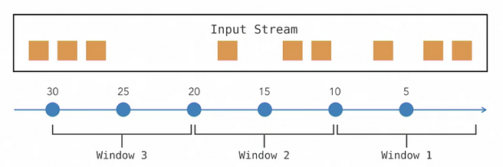
Tumbling window
A tumbling window is an equal-sized, continuous and non-overlapping window. A tumbling window is defined with a window interval.
For example as in fig , if we have a tumbling window with a window interval 10 seconds, every incoming event from the data stream for a duration of 10 seconds will fall into the same window.Tumbling window

Slide 56
Tumbling window
// tumbling event-time windows
stream.keyBy(<key selector>)
.window(TumblingEventTimeWindows.of(Time.seconds(5)))
// tumbling processing-time windows
stream.keyBy(<key selector>)
.window(TumblingProcessingTimeWindows.of(Time.seconds(5)))

Slide 57
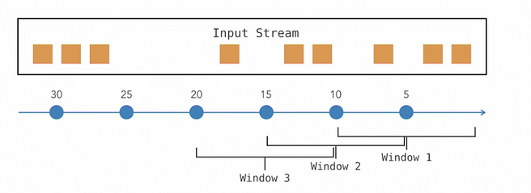
Sliding window
A sliding window is an overlapping window.
A sliding window is defined with a window interval and a sliding offset.
As we can see in figure , the window size is 10 second which starts from 0–10 s.
We have a sliding offset of 5 s and hence after 5 seconds, the window slides by 5 seconds and we get the second window in between 5–15 seconds.

Slide 58
Sliding window
//Sliding window for non keyed window
stream.timeWindowAll(
Time.seconds(10), //Window Size
Time.seconds(5)) //Slide by 5
// sliding event-time windows
stream.keyBy(<key selector>)
.window(SlidingEventTimeWindows.of(Time.seconds(10), Time.seconds(5)))
// sliding processing-time windows
stream.keyBy(<key selector>)
.window(SlidingProcessingTimeWindows.of(Time.seconds(10), Time.seconds(5)))

Slide 59
Session window
A session window covers all the elements that occur on a continuous basis. Session window is defined with a session boundary.
A session boundary is a period of inactivity during which there will be no incoming events.
Session windows do not overlap and do not have a fixed start and end time. A session window assigner can be configured with either a static session gap or with a session gap extractor function which defines how long the period of inactivity is.

Slide 60
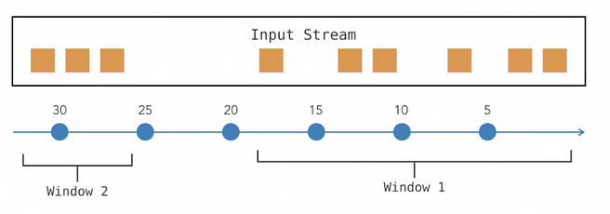
Session window
For example in figure , we have a session window with a session boundary of 5 sec. As long as we have incoming events within a gap of session boundary, they belong to the same window. Hence we have all the events from 0–19s in the window one. From time 19s to 26s we do not have any incoming events and the time gap is greater than the defined session boundary(5s). Hence we have a new window from time 26s.

Slide 61
Session window
// session processing-time windows (static gap)
stream.keyBy(<key selector>).window(ProcessingTimeSessionWindows
.withGap(Time.seconds(5))) //session gap
// session event-time windows (static gap)
stream.keyBy(<key selector>).window(EventTimeSessionWindows
.withGap(Time.seconds(5))) //session gap

Slide 62
Session window
// session event-time windows (dynamic gap)
stream.keyBy(<key selector>)
.window(EventTimeSessionWindows.withDynamicGap((element) -> {
// determine and return session gap
}))
// session processing-time windows (dynamic gap)
stream.keyBy(<key selector>)
.window(ProcessingTimeSessionWindows.withDynamicGap((element) -> { // determine and return session gap
}))

Slide 63
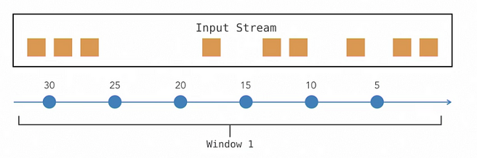
Global Window
A Global window considers the entire stream as a single window.
As mentioned in figure , we will have all the events belonging to the same window
stream.keyBy(<key selector>)
.window(GlobalWindows.create())

Slide 64
User-defined Window
This is a custom window defined by the user by extending the WindowAssigner class.

Slide 65
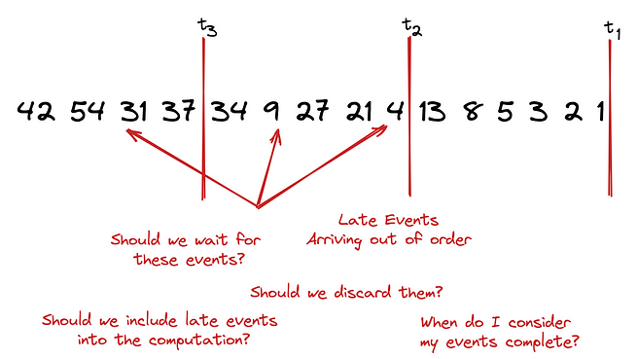
Watermark
Consider the following event stream and assume we want to perform different operations like sorting the events or performing some aggregates. We perform these operations in specified time intervals, i.e from t1 to t2, t2 to t3, and so on.
As depicted in the picture we can observe events arriving late and out of order. So we ask ourselves:
When do I consider my results complete?
How long should I wait to make sure events don’t arrive out of order?

Slide 66
Watermark
A watermark helps us address these questions as it provides a way to keep track of the progress of time.
In a stream of events if we see a watermark of time t we know that up to this specific point in time t the stream is complete. — or at least we consider it complete.

Slide 67
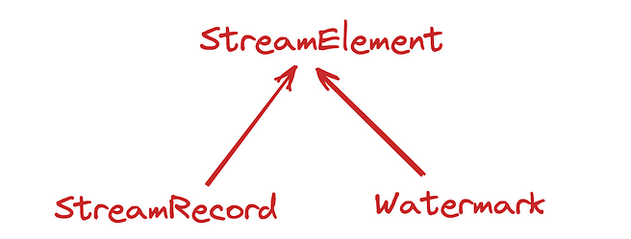
Watermark : How it works
All the events flowing through Flink pipelines and being processed are considered StreamElements.
These StreamElements can be either StreamRecords (i.e every event that is being processed) or a Watermark.
A watermark is nothing more than a special record injected into the stream that carries a timestamp (t).
It flows through the operators and tells each operator that no elements with a timestamp older or equal to the watermark timestamp (t) should arrive.
This way the operator knows that all the results up to this point in time, can be considered complete and is ready to emit those results.

Slide 68
Watermark : How it works
All the events flowing through Flink pipelines and being processed are considered StreamElements.
These StreamElements can be either StreamRecords (i.e every event that is being processed) or a Watermark.
A watermark is nothing more than a special record injected into the stream that carries a timestamp (t).
It flows through the operators and tells each operator that no elements with a timestamp older or equal to the watermark timestamp (t) should arrive.
This way the operator knows that all the results up to this point in time, can be considered complete and is ready to emit those results.

Slide 69
Table API and SQL

Slide 70
Introduction to Table API and SQL
Table API
SQL
Declarative programming interface for Apache Flink to perform relational operations on tables
Standard SQL queries can be executed directly on Apache Flink tables for data processing

Slide 71

Java Code Examples for Table API
01
Table Environment
Create a TableEnvironment to work with Table API and SQL in Java.
02
Table Creation
Define a Table using the Table API in Java by specifying schema and registering it.

Slide 72
Flink Connector
In Apache Flink, connectors are used to integrate Flink with various data sources and sinks. These connectors allow Flink to consume data from external systems (sources) and send processed data to external systems (sinks). Here are some of the popular connectors available in Flink:

Slide 73
Flink Connector
1. Kafka Connector
Flink Kafka Source and Sink: Used to consume data from and produce data to Apache Kafka. It supports both Kafka versions 0.x and 1.x+.
Flink Kafka SQL Connector: Allows reading from and writing to Kafka topics using SQL in Flink.
2. File System Connectors
File Source and Sink: Reads and writes data to various file systems, including HDFS, S3, and local file systems. Supported formats include CSV, JSON, Avro, Parquet, etc.
3. JDBC Connector
JDBC Source and Sink: Enables reading from and writing to relational databases using JDBC. It supports various databases like MySQL, PostgreSQL, Oracle, SQL Server, etc.

Slide 74
Flink Connector
4. Cassandra Connector
Cassandra Sink: Writes data to Apache Cassandra, a NoSQL database designed for high availability and scalability.
5. ElasticSearch Connector
ElasticSearch Sink: Writes data to ElasticSearch, a search engine based on the Lucene library, often used for log and search analytics.
6. Kinesis Connector
Flink Kinesis Source and Sink: Integrates with Amazon Kinesis to consume and produce data streams. Useful for real-time data analytics in AWS environments.
7. HBase Connector
HBase Source and Sink: Reads from and writes to Apache HBase, a distributed, scalable, big data store.

Slide 75
Flink Connector
8. MongoDB Connector
MongoDB Sink: Writes data to MongoDB, a popular NoSQL document-oriented database.
9. Pulsar Connector
Pulsar Source and Sink: Integrates with Apache Pulsar for consuming and producing data streams, similar to Kafka.
10. RabbitMQ Connector
RabbitMQ Source and Sink: Supports integrating with RabbitMQ, a message broker used widely for queuing and asynchronous messaging.
11. Redis Connector
Redis Sink: Writes data to Redis, an in-memory data structure store used as a database, cache, and message broker

Slide 76
Flink Connector
12. NATS Connector
NATS Source and Sink: Integrates with NATS, a lightweight, high-performance messaging system.
13. Pravega Connector
Pravega Source and Sink: Allows integration with Pravega, a storage system for streaming data that is designed for long-term storage and real-time processing.
14. Azure Event Hubs Connector
Azure Event Hubs Source and Sink: Integrates with Azure Event Hubs, a big data streaming platform and event ingestion service.
15. Google Pub/Sub Connector
Google Pub/Sub Source and Sink: Enables consuming and producing messages to Google Cloud Pub/Sub, a messaging service that scales automatically based on demand.

Slide 77
Flink Connector
16. HTTP Connector
HTTP Source and Sink: Supports sending and receiving data over HTTP, useful for RESTful integrations.
17. Hive Connector
Hive Source and Sink: Reads from and writes to Apache Hive, a data warehouse system built on top of Hadoop.
18. Debezium Connector
Debezium Source: Captures changes from a variety of databases, including MySQL, PostgreSQL, Oracle, and SQL Server, and streams them to Flink for processing.
19. Socket Connector
Socket Source and Sink: Provides simple socket-based connections, useful for testing and simple network-based data exchanges.
20. MQTT Connector
MQTT Source and Sink: Integrates with MQTT brokers for lightweight messaging often used in IoT scenarios.

Slide 78
Java Code Examples for SQL Queries
Table API
SQL CLI
Write SQL queries using Table API for data processing.
Use SQL CLI to execute SQL queries directly on Apache Flink.

Slide 79
Windows and Checkpointing

Slide 80
Understanding Windows in Apache Flink
Tumbling Windows
Non-overlapping fixed-size windows for processing data streams. This is time based windowing
Sliding Windows
Overlapping windows that slide by a specified interval to process continuous data streams. This is also time based windowing
Session Windows
Dynamically grouped windows based on the activity period of data items
Global Window
Count Window
once the count reaches a new window starts. it is keyed stream.

Slide 81
Importance of Checkpointing in Apache Flink
Fault Tolerance
State Management
Performance Optimization
Ensures data consistency and fault recovery in case of failures
Allows for maintaining the state of streaming applications for fault recovery and savepoints
Improves performance by reducing the overhead of reprocessing data in case of failures

Slide 82
Conclusion

Slide 83

Key Takeaways from the Presentation
01
Real-time data processing
Apache Flink enables real-time data processing with low latency and high throughput.
02
Fault tolerance
Flink provides fault tolerance mechanisms to ensure data consistency and reliability.
03
Scalability
With Flink's distributed architecture, it allows seamless scalability to handle large volumes of data efficiently.

Slide 84

Future of Apache Flink
Enhanced real-time processing
Apache Flink will continue to improve real-time data processing capabilities.
Seamless integration with AI
Future developments will focus on integrating Apache Flink with artificial intelligence technologies.
Extended support for IoT
Apache Flink is expected to provide enhanced support for Internet of Things applications.

Slide 85
Q&A Session
Real-time processing
Apache Flink enables real-time data processing with low latency and high throughput.
Fault tolerance
Flink provides fault tolerance mechanisms to ensure data consistency and reliability during stream processing.

Slide 86
Thank You
Name

